Slide 1
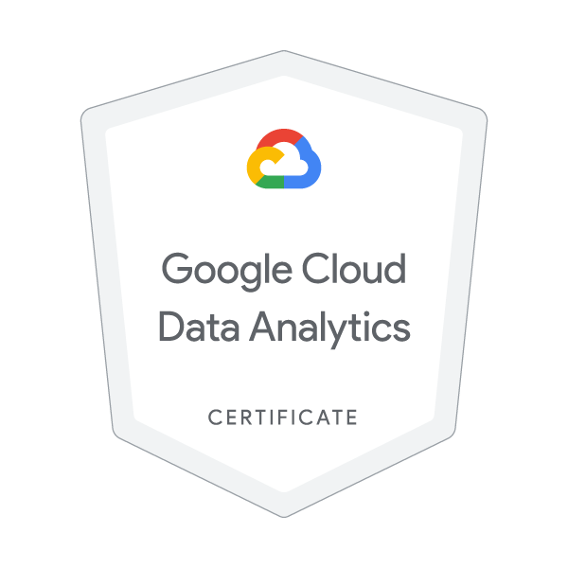
GOOGLE CLOUD DATA ANALYTICS
By,
Inchara S
4VV22IS041

Slide 2
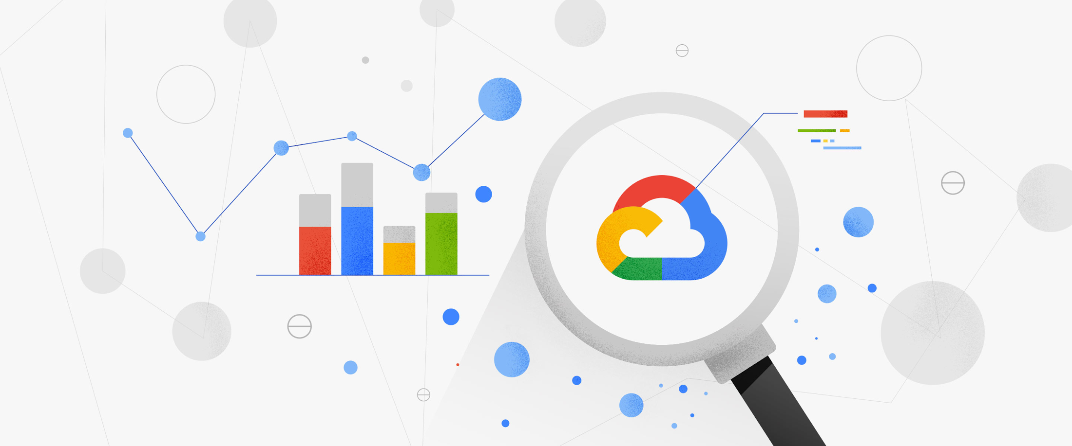
What is Cloud Data Analytics?
Cloud data analytics refers to the practice of storing and analyzing data in the cloud to extract valuable business insights.
It leverages cloud computing resources to process and analyze large datasets, enabling businesses to identify trends, make predictions, and improve decision-making.
Cloud analytics offers scalability, cost-effectiveness, and accessibility, making it a popular alternative to traditional on-premises data analytics

Slide 3
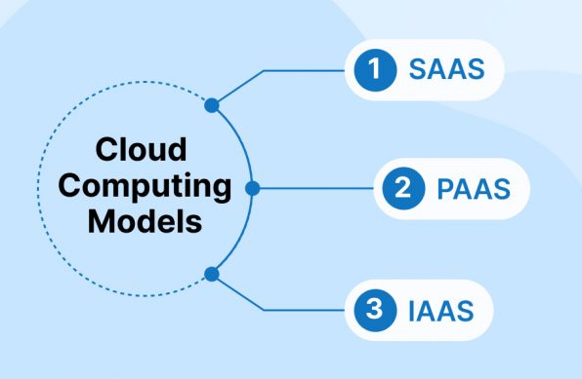
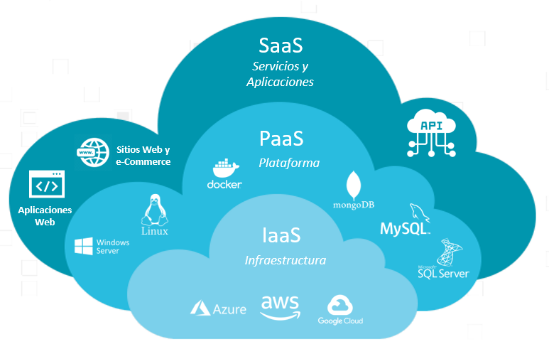
Cloud Computing Service Models

Slide 4
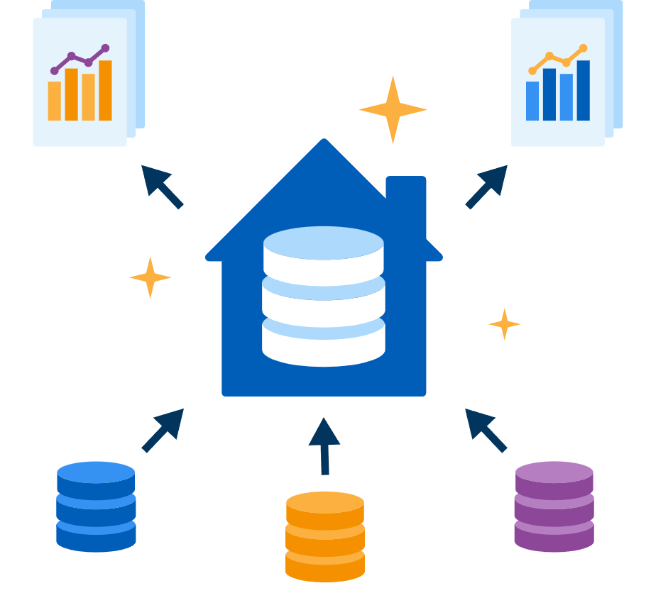
What is a Cloud Data Warehouse?
A cloud data warehouse is a data warehouse that exists in the cloud environment, capable of combining exabytes of data from multiple sources. Cloud data warehouses are designed to handle complex queries and are optimized for business intelligence (BI) and analytics.
Key Features of a Cloud Data Warehouse
Performance: Quick and efficient querying of large datasets.
Integration: Seamless integration with various analytics tools.
Security: Strong measures like encryption and access controls.
Cost Management: Pay-as-you-go model for cost-effectiveness.
Scalability: Easily adjusts to data volume and processing needs.
Accessibility: Data access from anywhere with an internet connection.
Automatic Updates: Regular automatic updates for the latest features and security patches.

Slide 5
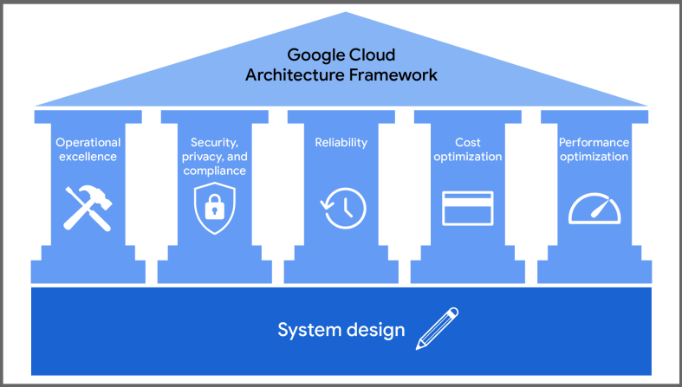
Google Cloud Architecture Framework

Slide 6
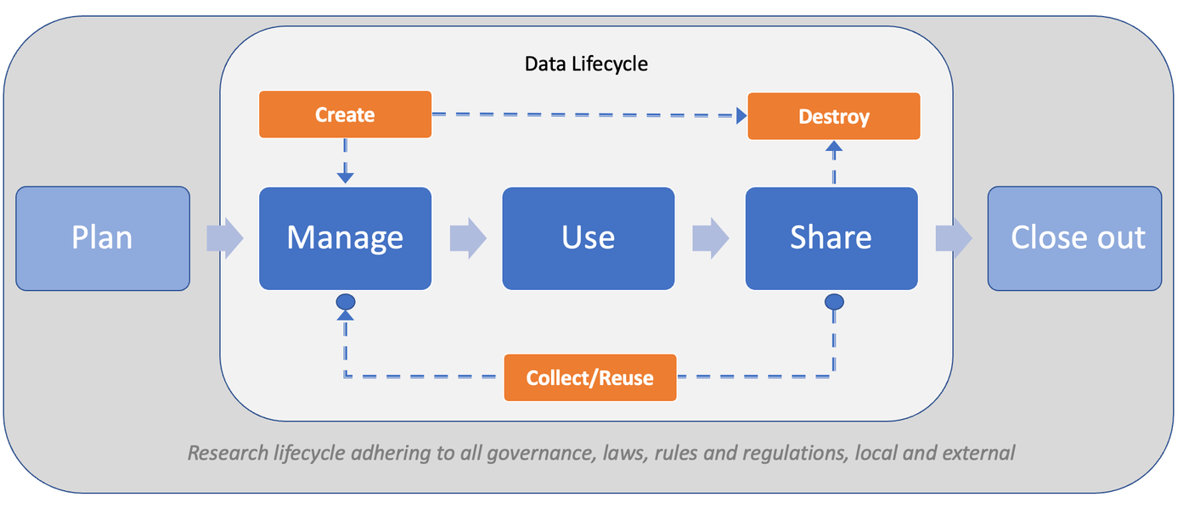
Data Lifecycle

Slide 7
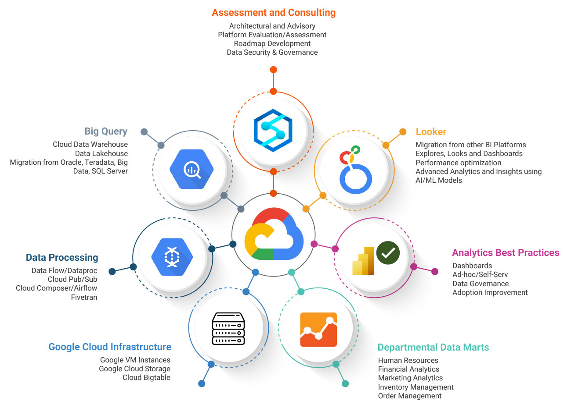
Google Cloud Data Analytics tools

Slide 8
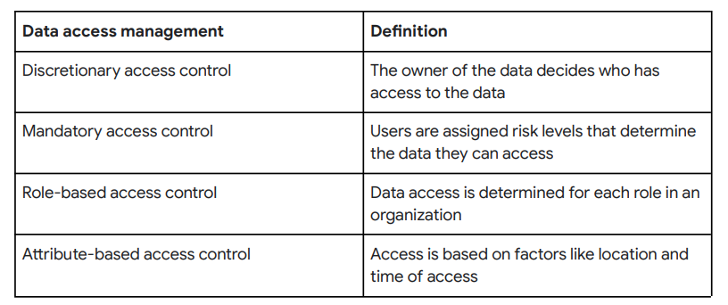

Data Access Management
Data access management is the process of using features like password protection, user permissions, and encryption to safeguard data and related processes
Methods of Data Access Management

Slide 9

Thank You :)

